Slide 1
Zomato ANALYTICS Project

Slide 2
AGENDA
Introduction
Objectives
Problem Statement
KPIs and Insights
Excel Dashboard
Tableau Dashboard
SQL Queries Output
Power BI Dashboard
Project Summary

Slide 3
INTRODUCTION
A Zomato Analytics Dashboard provides a visual representation of key metrics and insights related to Zomato's platform performance.
It typically includes data on customer behavior, restaurant performance, order trends, revenue, and user engagement. This dashboard helps stakeholders like restaurant owners, marketing teams, and operations managers monitor business health, track KPIs, identify growth opportunities, and optimize decision-making through data-driven insights, such as sales trends, customer demographics, and popular cuisines.

Slide 4
OBJECTIVES
The objectives of a Zomato Analytics Dashboard are to:
Track key performance indicators (KPIs) like orders and revenue.
Analyze customer behavior and preferences.
Optimize sales by identifying top performers and trends.
Improve operational efficiency (delivery, cancellations).
Measure marketing campaign effectiveness.
Monitor competitor performance for growth opportunities.
These goals enable data-driven decision-making and business improvement.

Slide 5
PROBLEM STATEMENT
Zomato needs a comprehensive, real-time analytics tool to track key performance metrics, customer preferences, and operational efficiency. Without such insights, restaurants and Zomato risk missing growth opportunities, optimizing sales, improving customer experience, and managing marketing effectiveness. The lack of data-driven decision-making limits competitiveness and operational improvements in a fast-evolving food delivery industry.

Slide 6
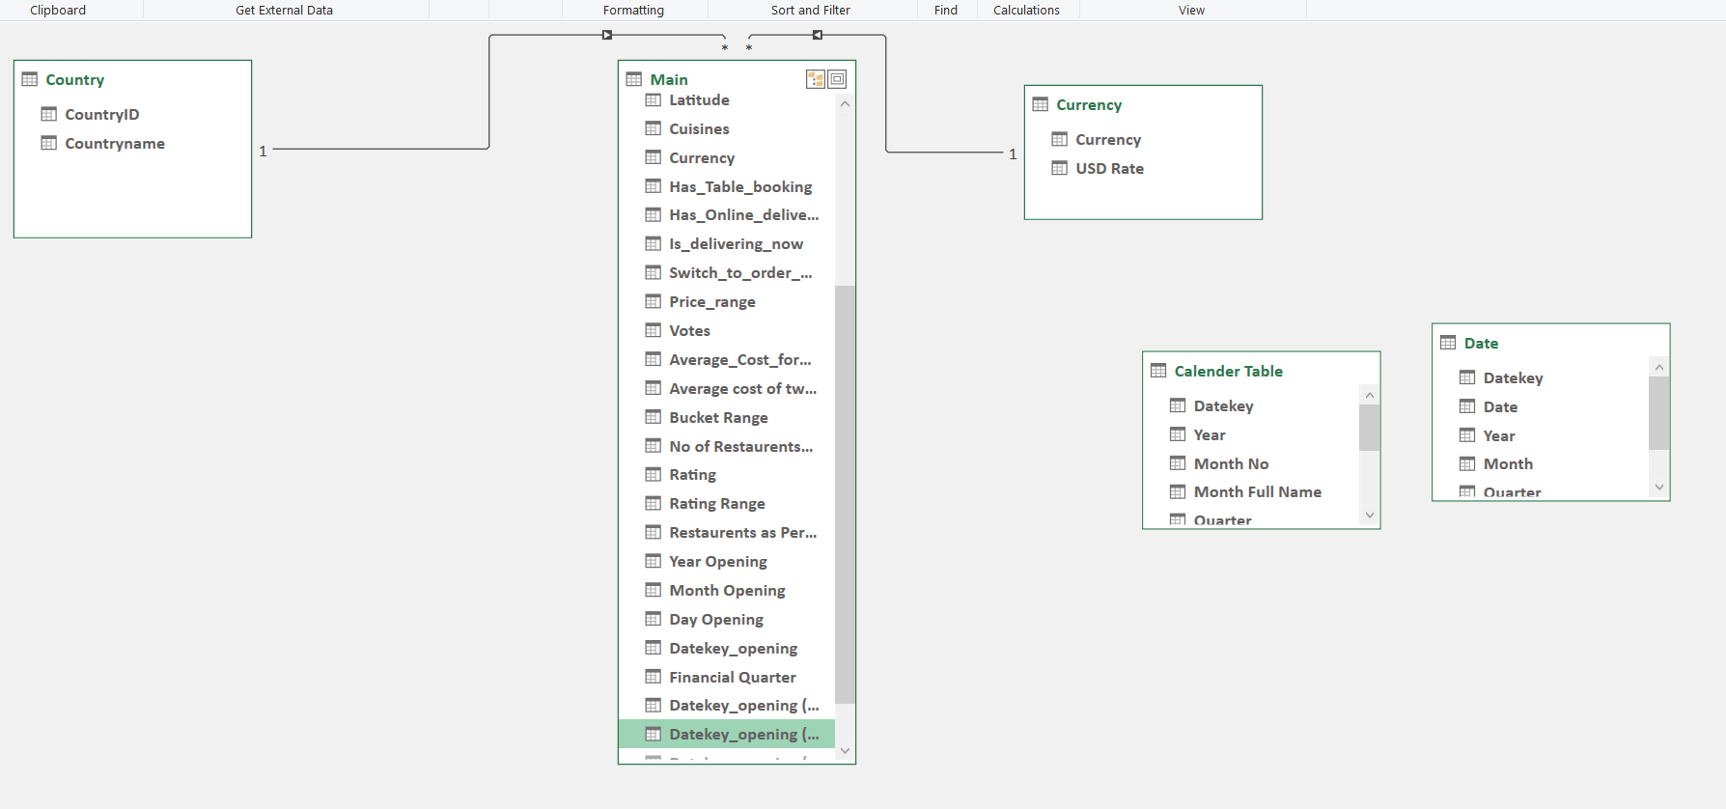
DATA SUMMARY
Dataset (Excel Sheet):
Country
Currency
Main
DATA MODELLING

Slide 7
KPI LIST
Build a country Map Table
Build a Calendar Table using the Column Datekey
Add all the below Columns in the Calendar Table using the Formulas.
A.Year
B.Monthno
C.Monthfullname
D.Quarter(Q1,Q2,Q3,Q4)
E. YearMonth ( YYYY-MMM)
F. Weekdayno
G.Weekdayname
H.FinancialMOnth ( April = FM1, May= FM2 …. March = FM12)
I. Financial Quarter ( Quarters based on Financial Month)
Find the Numbers of Resturants based on City and Country.
Numbers of Resturants opening based on Year , Quarter , Month
Count of Resturants based on Average Ratings
Create buckets based on Average Price of reasonable size and find out how many resturants falls in each buckets
Percentage of Resturants based on "Has_Table_booking"
Percentage of Resturants based on "Has_Online_delivery"
Develop Charts based on Cusines, City, Ratings

Slide 8
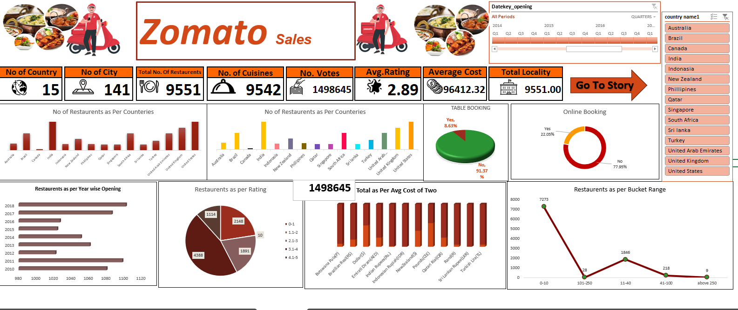
EXCEL DASHBOARD

Slide 9
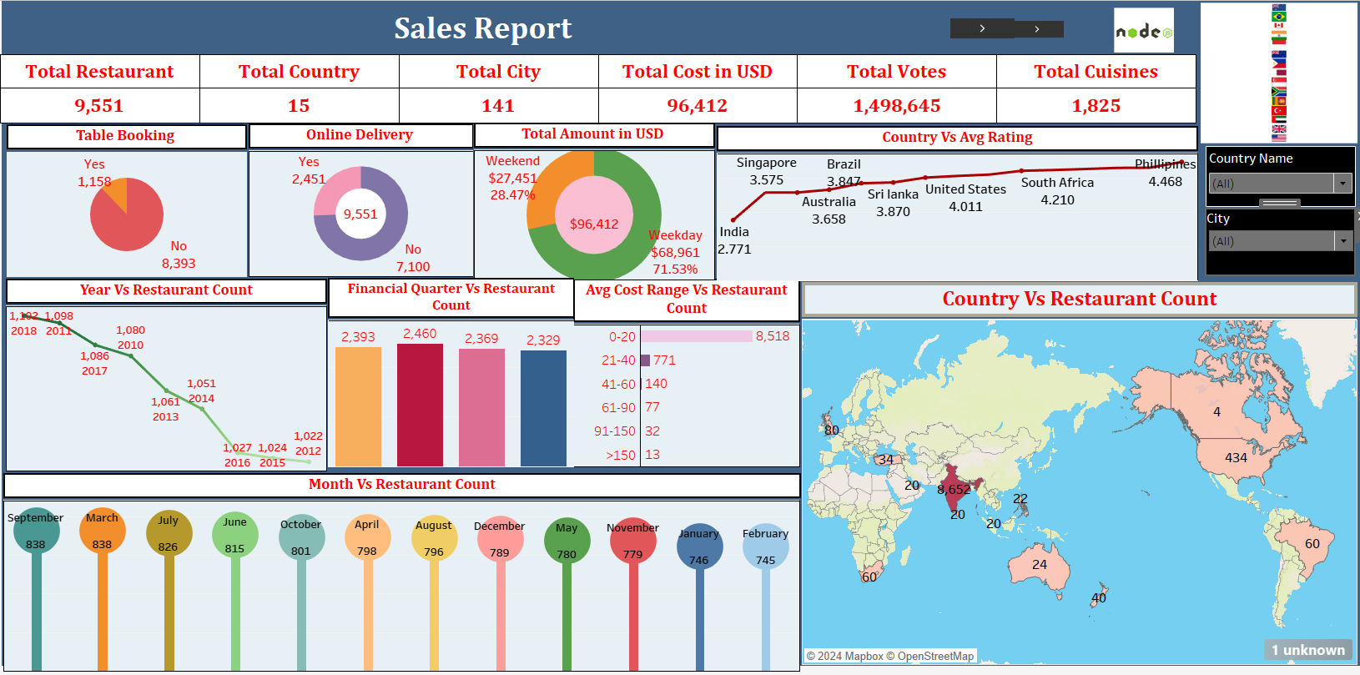
TABLEAU DASHBOARD

Slide 10
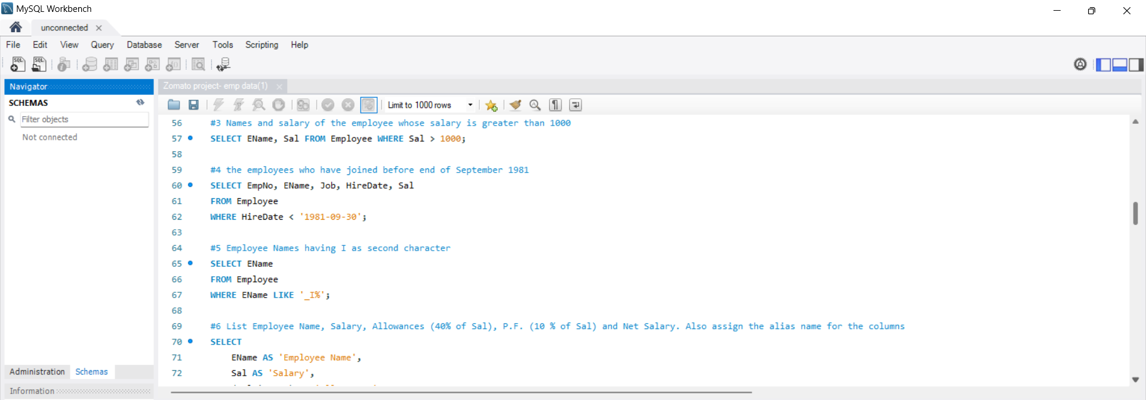
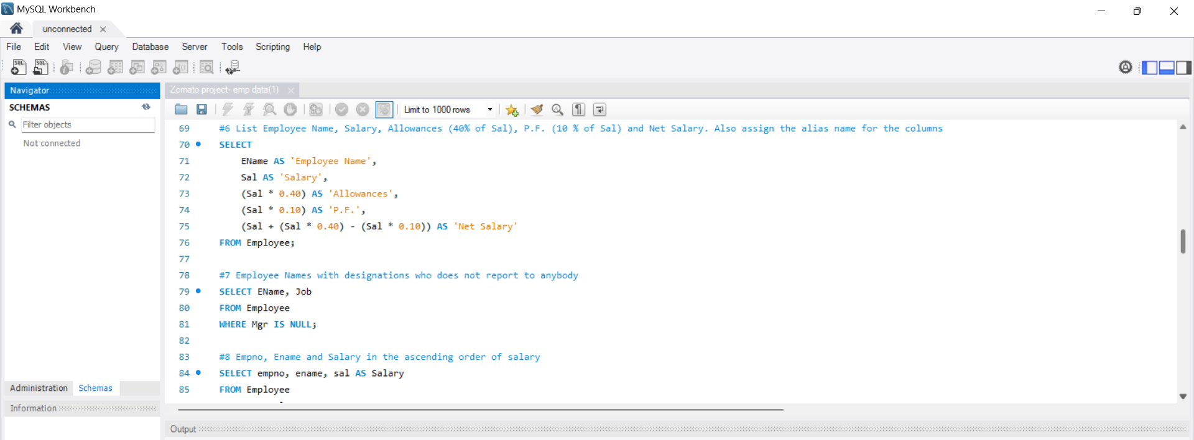
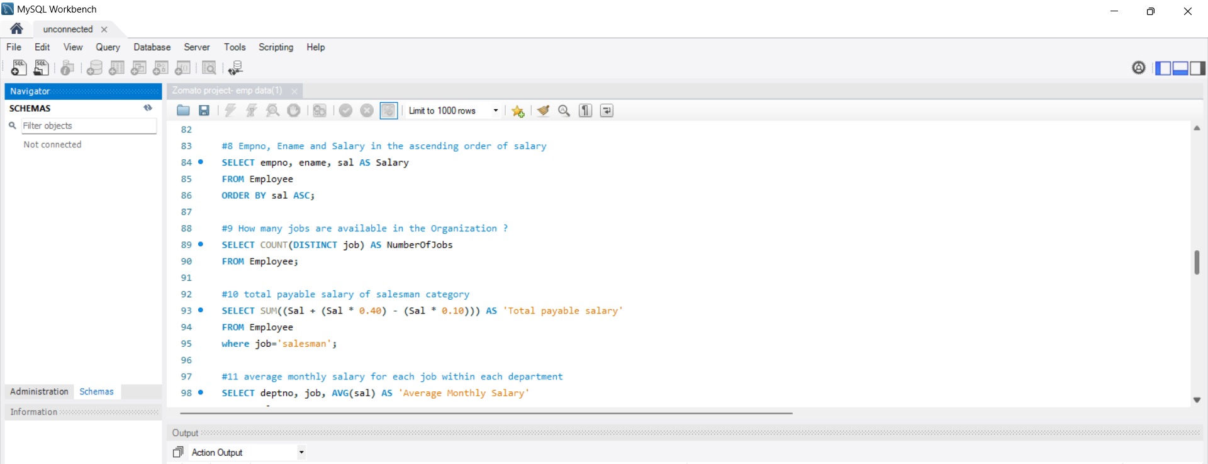
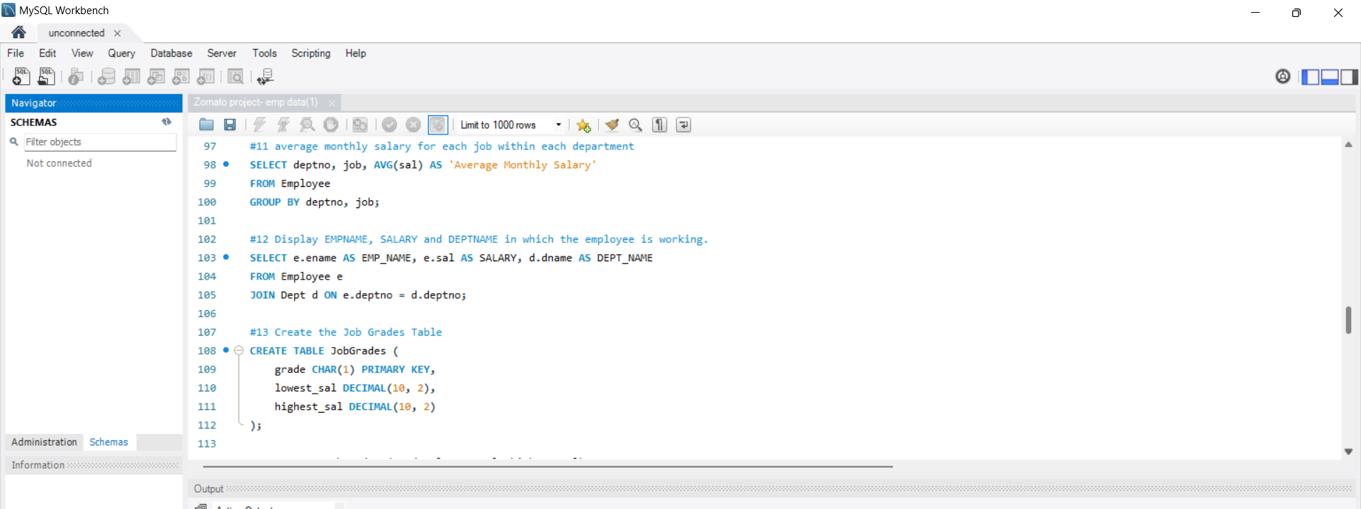
SQL QUERIES

Slide 11
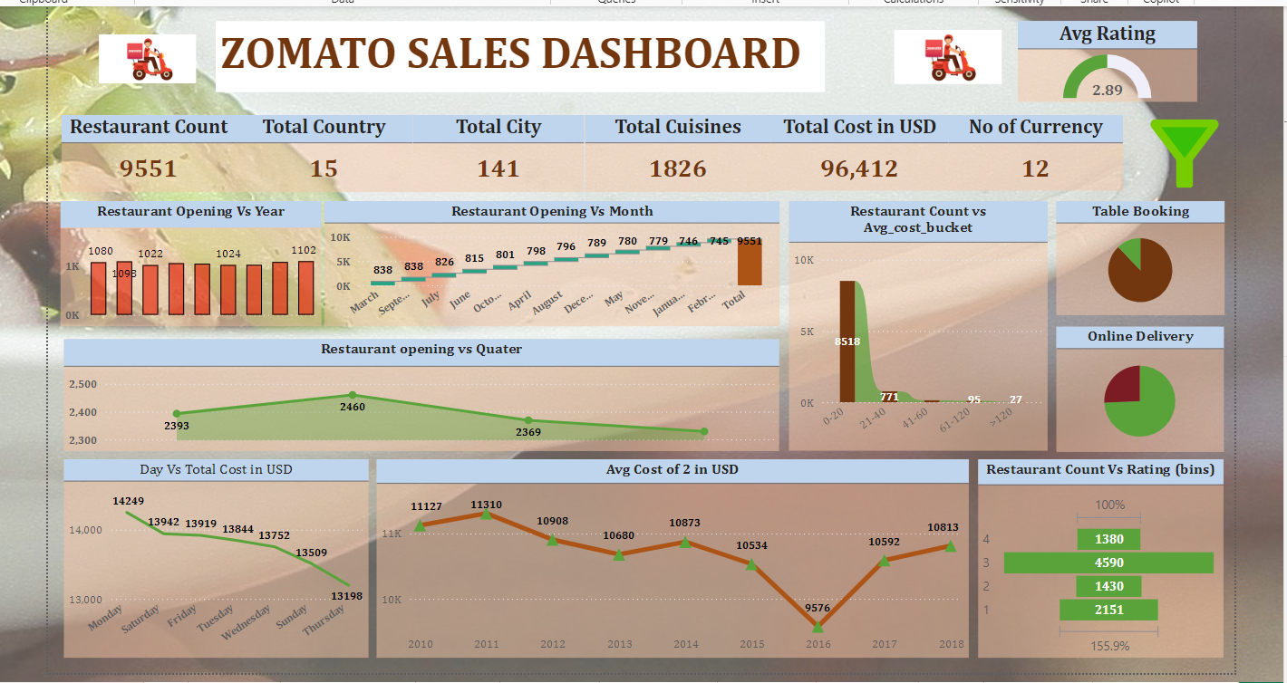
POWER BI DASHBOARD

Slide 12
PROJECT SUMMARY
The Zomato Sales Dashboard provides a comprehensive overview of key metrics, including:
Total Restaurants: 9,551 across 141 cities in 15 countries.
Total Cuisines: 1,826.
Total Cost (USD): $96,412.
Average Rating: 2.89.
Restaurant Openings: By year, month, and quarter.
Cost Buckets: Distribution of restaurant counts by average cost per order.
Online Delivery vs. Table Booking: Visual representation of service types.
Day vs. Total Cost & Avg. Cost for Two: Daily cost patterns and average spending trends.
This dashboard helps track restaurant growth, cost analysis, and customer behavior.

Slide 13
IMPROVEMENTS
Here are some key improvements for Zomato's analytics:
Enhanced Data Integration: Streamline data from various sources (restaurant partners, user reviews, social media) for a holistic view.
Real-time Analytics: Implement real-time data tracking to respond quickly to trends and user preferences.
User Segmentation: Develop advanced user segmentation for personalized marketing and recommendations.
Feedback Analysis: Automate sentiment analysis on reviews to gauge customer satisfaction and identify areas for improvement.
Competitor Benchmarking: Integrate competitor analysis to understand market positioning and identify growth opportunities.
Location-based Insights: Provide more detailed analytics based on geographical trends to help restaurants optimize their offerings.
Performance Metrics: Establish clear KPIs for restaurants to track their performance against industry standards.
User Engagement Metrics: Analyze engagement metrics to enhance user experience and retention strategies.
Implementing these changes could greatly enhance Zomato's analytics capabilities and improve overall service.

Slide 14
CONCLUSION
In conclusion, data analytics plays a crucial role in enhancing Zomato's operations and customer experience. By leveraging data to understand user preferences, optimize delivery logistics, and personalize marketing efforts, Zomato can drive engagement and satisfaction. Furthermore, analyzing restaurant performance and market trends allows for informed strategic decisions, ultimately leading to improved profitability and competitive advantage. As Zomato continues to harness data analytics, it can adapt more effectively to market changes and consumer needs, ensuring sustained growth in the dynamic food service industry.

Slide 15

THANK YOU!

